Slide 1
Engagement and Acceleration: Leveraging Funds and Resources for All Accelerated Learners
GCEL 2018
Gail Humble, Program Manager, College Readiness and Talent Development
Joshua Todd, Program Specialist, College Readiness and Talent Development

Slide 2


Slide 3
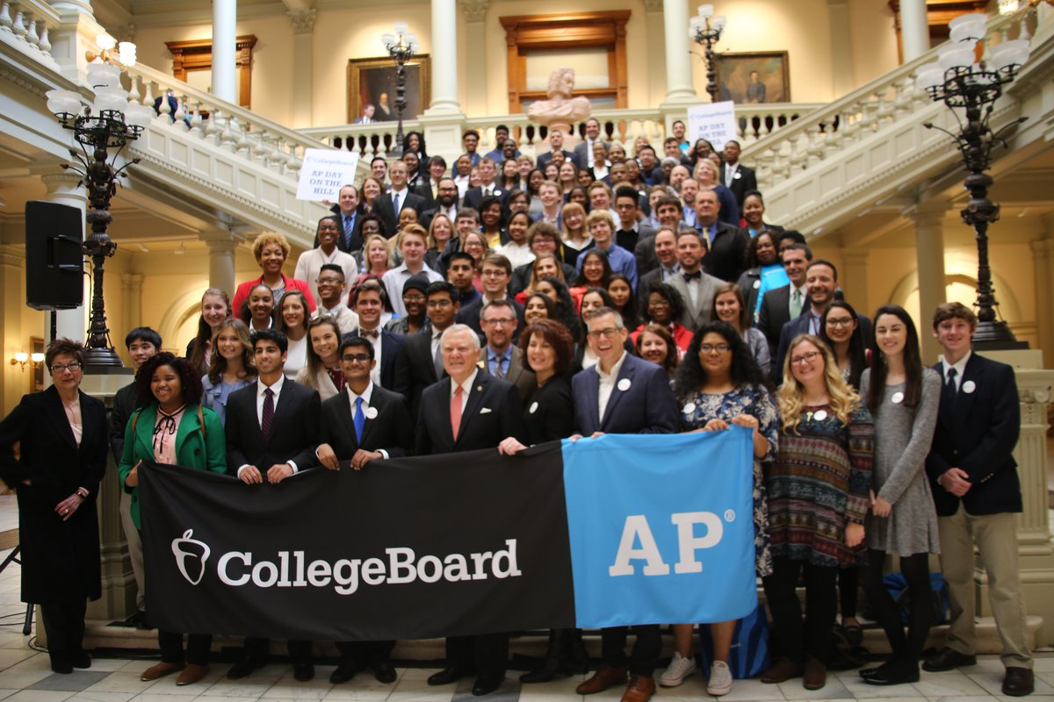
The Promise of Advanced Placement
AP connects students to college and advanced learning opportunities:
  2017 – More than 1,170,000 seniors used AP to get ahead in college
  Stand out in College Admissions
  Earn College Credits
  Advance into higher-level courses
  Build college skills
  Engage Students
Notes:
The picture is from the 2018 AP Day at the Capitol

Slide 4
Trends in Georgia’s
Advanced Placement Enrollment and Performance

Slide 5
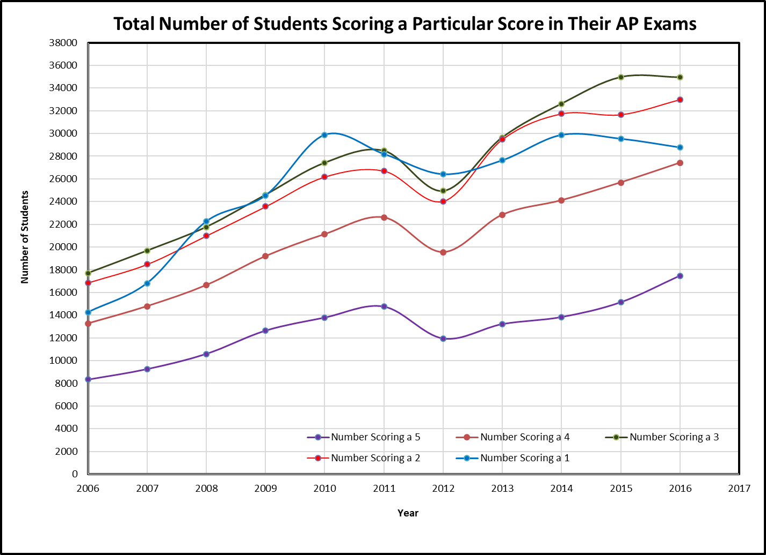
Year | Total Number of Exams | Percent Increase
2006 | 70,401
2007 | 79,017 | 12.24%
2008 | 92,232 | 16.72%
2009 | 104,502 | 13.30%
2010 | 118,367 | 13.27%
2011 | 120,706 | 1.98%
2012 | 106,857 | -11.47%
2013 | 122,804 | 14.92%
2014 | 132,147 | 7.61%
2015 | 136,944 | 3.63%
2016 | 141,563 | 3.37%
Notes:
The number of AP exams taken by Georgia students since 2006 has increased by 101% with the largest percent increases by year between 2006 and 2010 and then in 2013. The general trend was broken between 2011 and 2012.

Slide 6
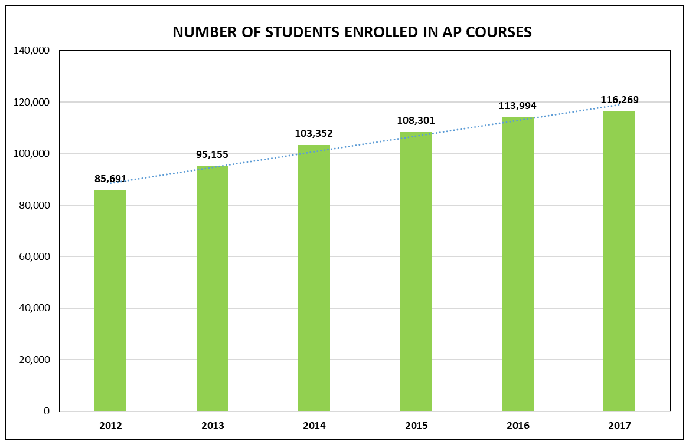
Notes:
Number of students enrolled in at least one AP course has increased by 35.7% since 2012
25, 283 AP exams for low-income students were funded by the state in 2017

Slide 7
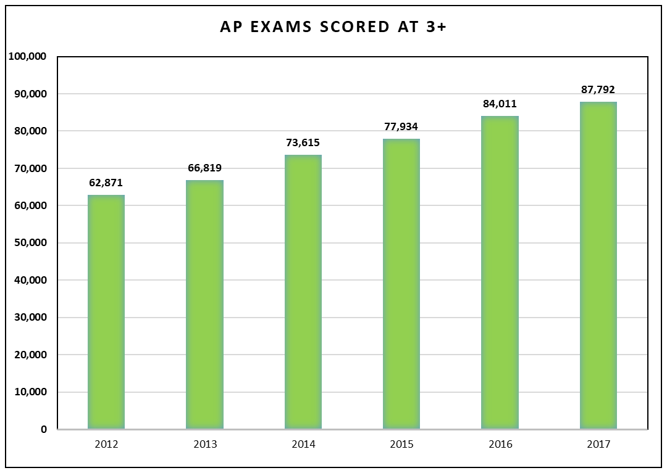
Notes:
Number of students scoring at 3 or higher on AP exams has increased by 39.6% since 2012

Slide 8
Georgia’s Low-income and Minority AP Data
2016 AP Data
2017 AP Data
32% of Georgia’s low-income students who completed an AP exam scored at 3 or higher
30% of Georgia’s African-American students who completed an AP exam scored at 3 or higher
45% of Georgia’s Hispanic students who completed an AP exam scored at 3 or higher.
38% of Georgia’s low-income students who completed an AP exam scored at 3 or higher
30% of Georgia’s African-American students who completed an AP exam scored at 3 or higher
47% of Georgia’s Hispanic students who completed an AP exam scored at 3 or higher.

Slide 9
All Students Deserve the Opportunity to
Benefit from AP

Slide 10
Georgia AP and Non-score Sending Challenge

Slide 11
Georgia 2016 Cohort Analysis of Non-sending AP Scores
49% or 21,553 of the 43,804 Georgia high school graduates who took an AP examination in their senior year in 2016 did not send their AP report to any college or university.
Of the 157,623 AP examinations taken by those 43,804 Georgia high school seniors in 2016, the results of 48,293 exams or over 30% of the total exams taken by those seniors were not sent to any college or university.
Notes:
Despite Georgia’s success, our AP Score send numbers tell us we need to inform students, teachers, counselors, and parents of lost opportunities.

Slide 12
Georgia 2016 Cohort Analysis of Non-sending AP Scores
48,293 AP exams taken by the 21,553 non-report sending seniors, 31% or 14,937 of the exams had an AP grade of 3, 4, or 5.
Of the 14,937 exam grades of 3, 4, or 5 not sent to a college or university, over 11% or 1,740 of those exams had earned a grade of 5.
35% or 7,535 of the non-AP score sending Georgia students were low income students.
Notes:
Stephanie

Slide 13
Communication for Student Success
Fall Teacher Workshops –
Coordinators’ Session
Twitter
GaDOE Counselors’ Newsletter
Counselors’ Training Workshops
GaDOE Newsletter & E-Communications
Spring Campaign to include FY 17 Data
GaDOE Main Website
Webinar
Information Flyer for Parent Groups
Notes:
Stephanie

Slide 14
ESSA and Changes to AP Exam Funding

Slide 15
Well-Rounded Educational Opportunities
Title IV
Title I
Funds be used for a variety of purposes beyond AP, including funding accelerated learning programs or activities (i.e., reimbursing low-income students to cover all or part of AP or IB exams or increasing enrollment in these courses and dual enrollment)
Districts or schools receiving Title I funds may use those funds to cover a portion of AP Exam fees for low-income students. The funds must be used to supplement and not supplant any state or local funding for AP Exams.
Notes:
The SSAE program focuses on increasing the capacity of SEAs, LEAs, schools and local communities to provide all students with access to a well-rounded education; WREO included virtually anything that benefits accelerated learning students or programs. For next year, consider using funds to support AP, Gifted, or IB services including supporting exam fees and creating equal access to the progams (like using AP Potential Data from PSAT reports to place students in accelerated learning courses)

Slide 16
Changes to AP Exam Funding for 2018
Non Low-Income Students
Low-Income Students
Any non-low-income student enrolled in an AP STEM course may have one AP STEM exam paid in full by the state
Low-income students will have to choose between having either one AP STEM exam paid for or one non-AP STEM paid for by the state.
Notes:
Each student in Georgia is eligible to have one AP Exam paid for by the state
Unfortunately, the funds cannot be used at this time for the AP Capstone courses.
REMINDERS: Systems receiving CEP funds (Community Eligibility Program) cannot use this designation as a determining factor for low-income students. Instead, each students' eligibility will have to be determined as outlined on pages 22-23 of the AP Coordinator's Manual 2017-2018.
FEDERAL SEA FUNDS WILL NOT BE AVAILABLE NEXT YEAR TO SUPPLMENT

Slide 17
Resources for SAT, PSAT, and AP

Slide 18




Free, Official SAT® Practice Through Khan Academy
Full Length Practice Tests
Eight official practice tests, with more to come, plus study and test-taking tips
satpractice.org
Video Lessons
Easy-to-follow videos explain problems step-by-step
Interactive Problems & Instant Feedback
Get hints, explanations and constant progress updates to know where you stand
Daily Practice App
More practice available on your phone featuring questions of the day plus the ability to ease the Scan and Score feature
Notes:
Official SAT Practice through Khan Academy is free to all students
Personalized practice allows diagnostic accuracy when students link accounts
Intuitive interface, and clean design
College Board approved—created by those who write the assessments
Emphasis on skill-building
In-depth explanations of the practice questions
Partnerships with community-based organizations increase accessibility

Slide 20
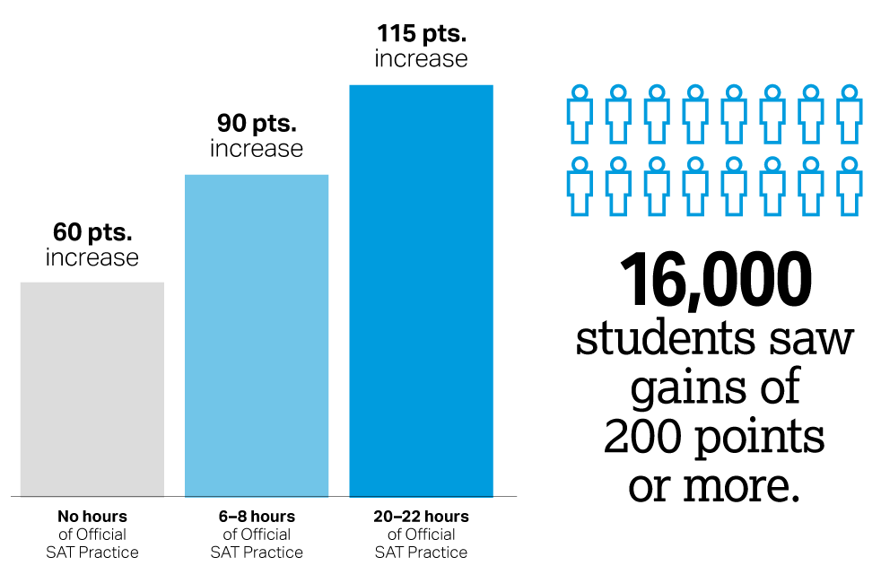
Score Improvements with and Without Official SAT Practice
Average number of points
gained from PSAT/NMSQT to SAT correlated to hours spent practicing on Khan Academy
Based on 250,000 students from the Class of 2017
There were 2,421 students in Georgia who linked their accounts and saw a 200 point increase between the PSAT/NMSQT and the SAT.
Notes:
Khan Academy and the College Board are releasing new data linking Official SAT Practice on Khan Academy to substantial student score gains from the PSAT/NMSQT to the redesigned SAT.
This extensive analysis includes nearly 250,000 students from the high school graduating class of 2017 who took the new PSAT/NMSQT and the new SAT in the past year. The results are encouraging.
Students who prepared using Official SAT Practice saw substantial improvement. 20 hours of practice was associated with an average 115-point increase from the PSAT/NMSQT to the SAT, nearly double the average gain among students who did not use Official SAT Practice.
We saw many students who are “knocking it out of the park.” More than 16,000 SAT test takers out of the total group studied experienced a score gain between the PSAT/NMSQT and SAT of 200 points or more. [For Background only: Among students who practiced Khan and experienced less than 200 point gains, the average practice time was 3.57 hours. By contrast among the “super-gainers,” the average practice time was nearly twice as high, at 6.94 hours.]
The College Board will further explore the role of motivation in producing these results as well as how best to encourage more students to practice productively.
Khan Academy and the College Board developed Official SAT Practice to create free, personalized tools so students, regardless of their income level or background, can prepare for the SAT and college-level courses.
Each student accesses a plan built just for them. By linking their College Board and Khan Academy accounts, students use their scores on the new SAT, PSAT/NMSQT, PSAT 10, and PSAT 8/9 to determine what areas to focus on.
Official SAT Practice reinforces what students learn in school by letting them focus on the knowledge and skills most essential for college.
Official SAT Practice is helping to level the playing field for students. For the first time, we are seeing equality of access to SAT practice.
There are more than 4 million unique users on Official SAT Practice.
As with score improvement, adoption has been consistent across demographics. These practice tools have been embraced already by so many because they are best-of-their kind tools and are available to everyone—no matter their background.
Behind every story of a student succeeding is a teacher, counselor, adviser, coach, parent, and other caring adults. Approximately 28% of Official SAT Practice usage happens during school hours. In the next year, Khan Academy and the College Board will continue to work with educators to support students’ SAT practice.
Nearly 40 percent of all test takers report using free Official SAT Practice, making it the number one tool for SAT preparation.

Slide 21
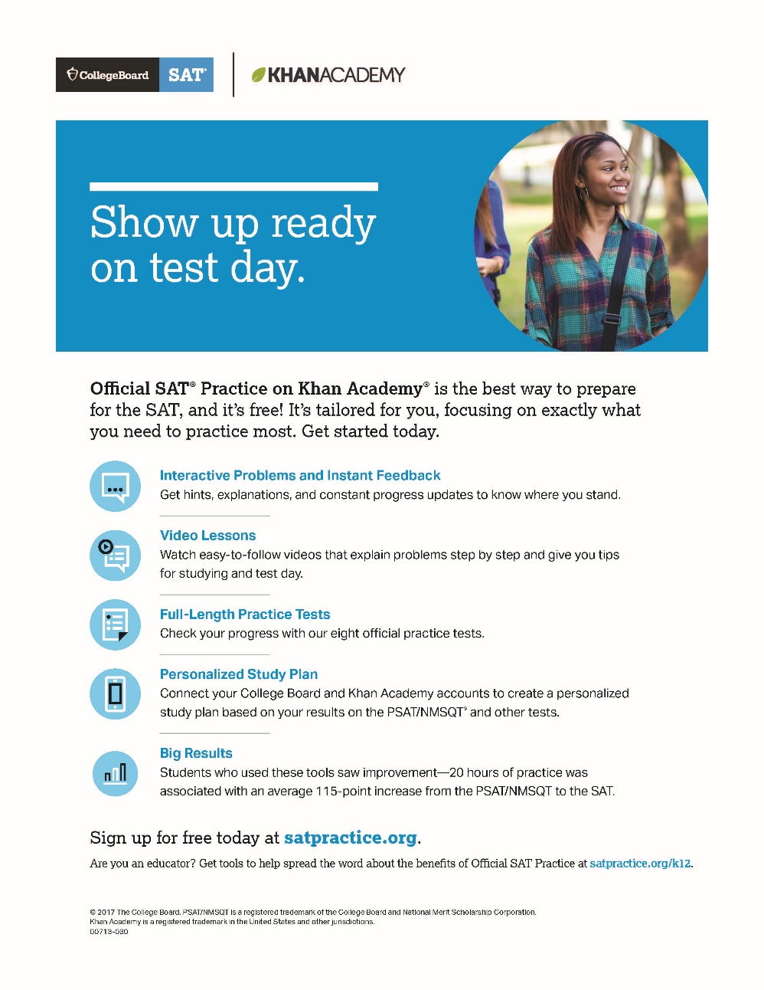
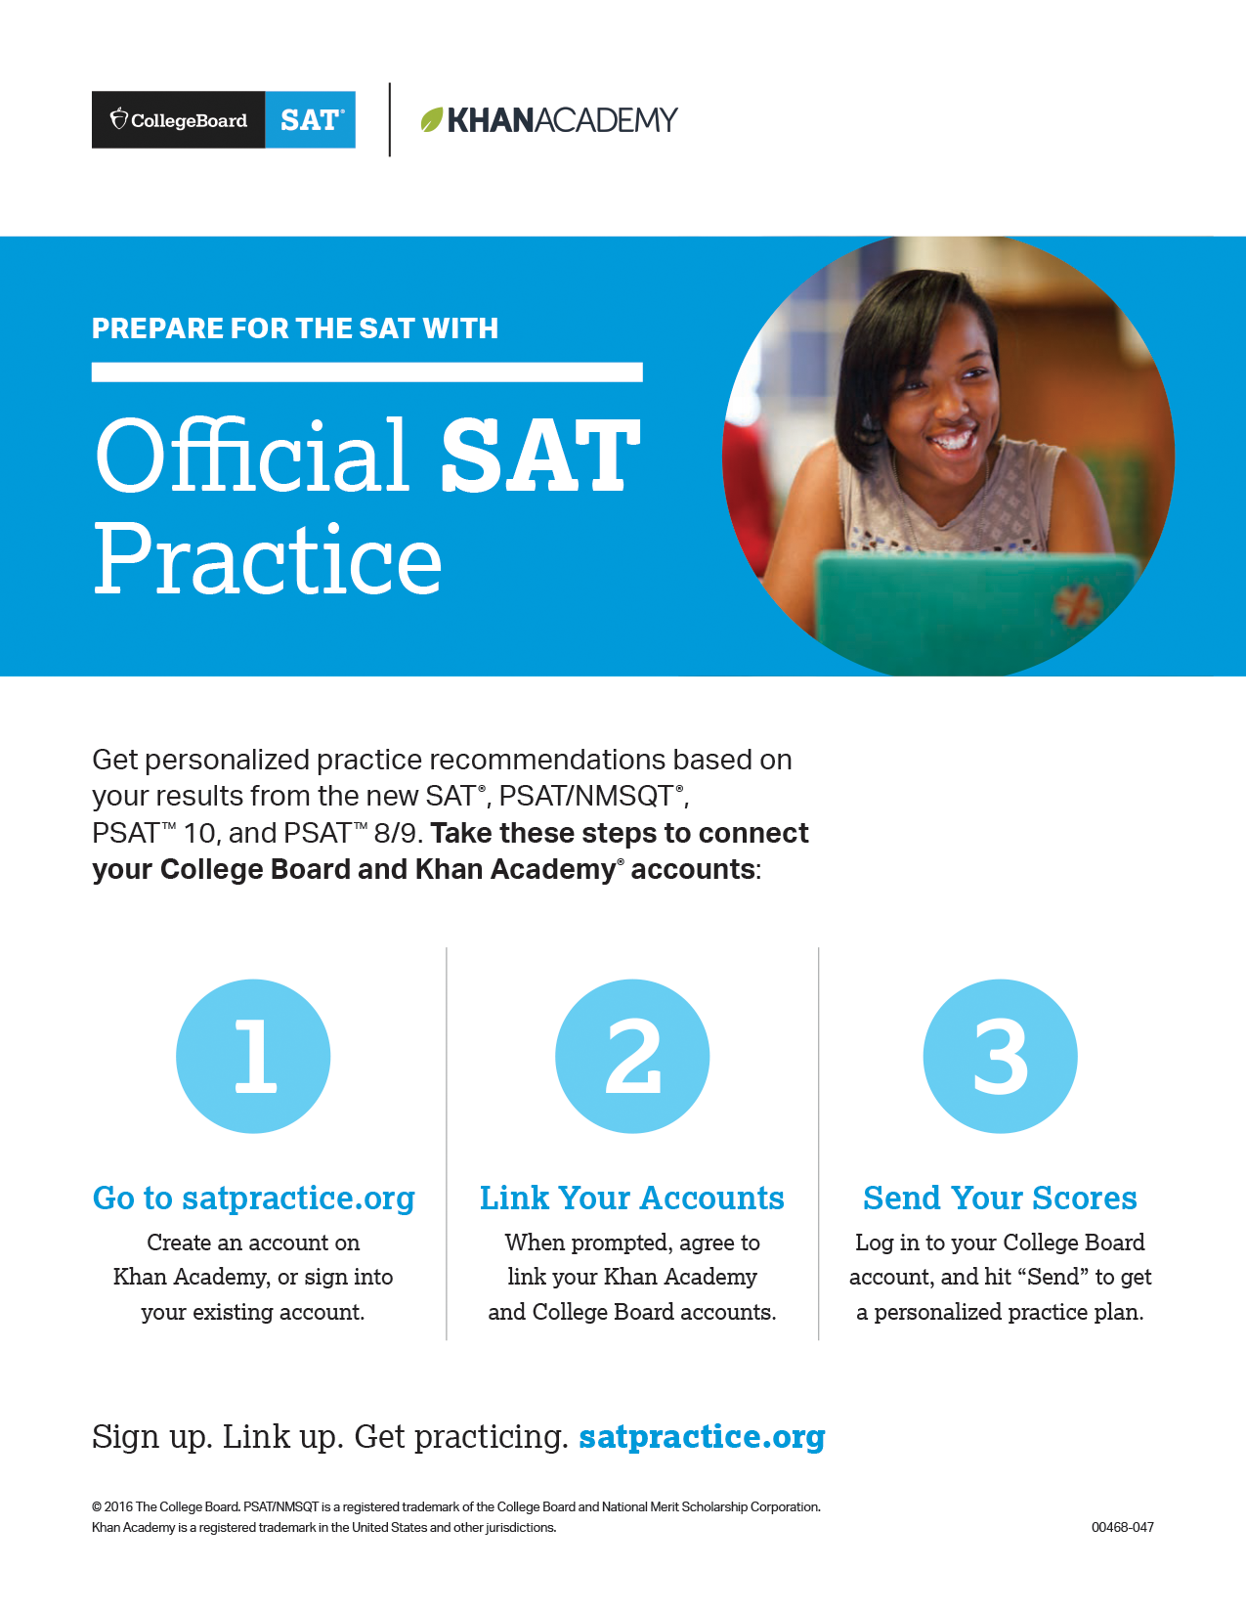
Khan Academy Resources
Go to satpractice.org/k12 for resources about Official SAT Practice on Khan Academy.
View sample study plans and study-group ideas at sat.org/studygroup.
Student resources for the SAT and PSAT-related assessments are at sat.org/k12.
Instructional videos on Khan Academy at youtube.com/collegeboard.

Slide 22
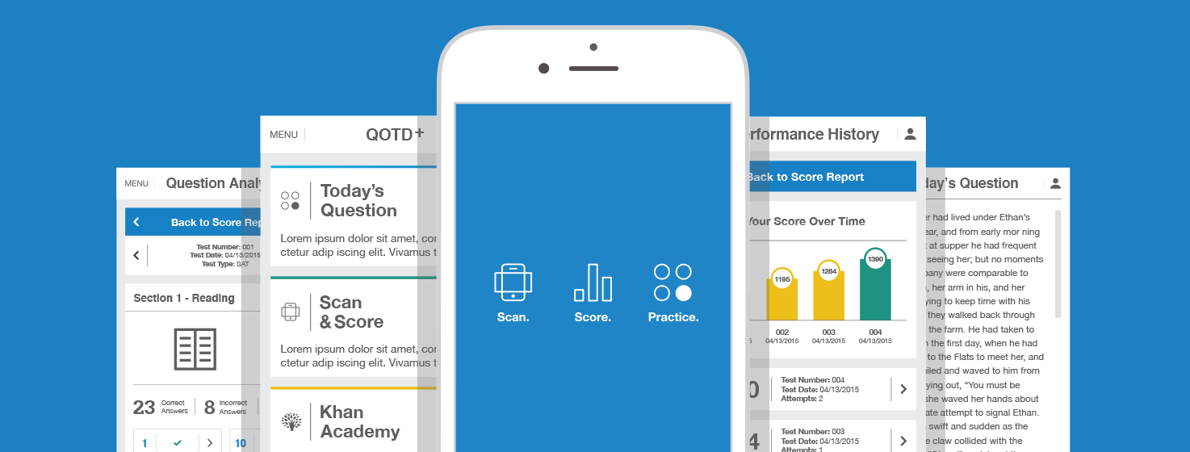
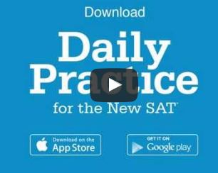
Daily Practice for the SAT
sat.org/scoring
Daily SAT practice questions
Instant practice test scoring

Slide 23

Follow us on Twitter
@GaDOECollegeRdy
and use
#collegereadyGA to celebrate successes

