Slide 1
Essential Components of
Title VI, Part B
Georgia Compensatory Educational Leaders
Inspire, Ignite, Innovate!
February 24-26, 2014
Cathy Buescher

Slide 2
Contents
Title VI, Part B Purpose
Eligibility:
  Small Rural School Achievement (SRSA)
  Rural and Low-Income Schools (RLIS)
Planning
Coordination with other federal programs
Allocations

Slide 3
Contents
Implementation:
  Allowable program activities
  Local use of funds
  Supplement not supplant
Budgeting Requirements
  Original budget
  Indirect cost
  Audit cost
  Amendments

Slide 4
Contents
Federal Requirements
  OMB Circulars
  EDGAR
Cross Functional Monitoring
Annual Evaluation Report
Accountability
  Georgia's Flexibility Waiver
Consolidated Application

Slide 5
PURPOSE

Slide 6
Purpose of Title VI, Part B
The purpose of the Title VI, Part B Rural Education Achievement Program (REAP) is to address the unique needs of rural LEAs that frequently:
Lack the personnel and resources needed to compete effectively for federal competitive grants; and
Receive formula grant allocations in amounts too small to be effective in meeting their intended purposes.

Slide 7
Purpose of Title VI, Part B
Title VI, Part B, Rural Education (REAP)
REAP is designed to assist rural LEAs in using federal resources more effectively to improve the quality of instruction and student academic achievement.
Rural education identified as an initiative and priority of the President and Secretary of Education.

Slide 8
ELIGIBILITY

Slide 9
Eligibility
REAP consists of two separate programs:
Small, Rural School Achievement (SRSA) [Section 6211]
Rural and Low-Income Schools (RLIS) [Section 6221]
  Local educational agencies (LEAs) must meet specific criteria in order to be eligible for either of the two programs.

Slide 10
SRSA
The Small Rural School Achievement (SRSA) Program
Rural school initiative with two components
  REAP-Flex – the Alternative Uses of Funds Authority
  The SRSA grant program

Slide 11
SRSA
Eligibility
To be eligible to participate in the SRSA grant and REAP-Flex program, an LEA must:
Have a total average daily attendance (ADA) of fewer than 600 students, OR
Serve only schools that are located in counties that have a population density of fewer than 10 persons per square mile; AND
Serve only schools that have an NCES school locale code of 7 or 8 (assigned by the US ED’s NCES) OR be located in an area of the state defined as rural by a governmental agency of the state.

Slide 12
RLIS
RLIS is an initiative that provides grant funds to rural LEAs that serve concentrations of children from low-income families.
The US ED awards funds by formula to SEAs, which in turn make sub-grants to LEAs either by formula or competitively.
Georgia uses a formula for making sub-grant awards.
An LEA may use RLIS funds to support a range of authorized activities in order to assist the LEA in meeting the state’s academic achievement standards and state academic assessments.

Slide 13
RLIS
Eligibility
An LEA is eligible to receive funds under the RLIS program if:
20 percent or more of the children age 5 to 17 served by the LEA are from families with incomes below the poverty line.
All schools served by the LEA have a school locale code of 6, 7, or 8 assigned by the National Center for Educational Statistics (NCES).
The LEA is not eligible to participate in the Small Rural School Achievement (SRSA) program.

Slide 14
PLANNING

Slide 15
FUND THE PLAN
Funds should be used to fund district or school initiatives based on identified needs.
Funds should supplement what is provided by other local, state and federal resources.
Funds should not “stand alone” but should be part of the comprehensive School Improvement Plan.
Funds should be budgeted in collaboration with other federal programs.

Slide 16
COORDINATION WITH OTHER FEDERAL PROGRAMS

Slide 17
COORDINATION
Title VI, Part B funds should extend or enhance the activities of other federal programs when needed.
Title VI, Part B program activities should be planned in coordination and collaboration with the district leadership team.
Collaboration will increase the effectiveness of the program by avoiding duplications and working together to maximize funds for programs that benefit students.

Slide 18
ALLOCATIONS

Slide 19
ALLOCATIONS
The US ED awards SRSA funds directly to eligible LEAs on the basis of a statutory formula.
The US ED awards RLIS funds by formula to the GaDOE, which in turn make sub-grants to LEAs by formula.
Allocations must be State Board approved and are awarded to LEAs in early Fall.
Twenty-five percent carryover is allowed from one fiscal year to the next.
In a given fiscal year, carryover funds must be expended first, followed by 75% of the current fiscal year allocation.
Grant award period is from July 1 through September 30.

Slide 20
IMPLEMENTATION

Slide 21
Small Rural School Achievement
(SRSA)

Slide 22
SRSA
REAP FLEX – Alternative Uses of Funds Authority
Provides LEAs with greater flexibility in using the formula grant funds that they receive under certain state-administered federal programs.
This component of SRSA is not a grant program; does not provide funding.
REAP FLEX gives greater latitude in spending funds that LEAs receive under other federal programs so that they can better address their particular needs.

Slide 23
SRSA
REAP FLEX – Alternative Uses of Funds Authority
REAP-Flex does not involve a transfer of funds from one program to another.
REAP-Flex gives an LEA broader authority in spending “applicable funding” for alternative uses under selected federal programs.
“Applicable funding” is the funding for which an eligible LEA may exercise its REAP-Flex authority.

Slide 24
SRSA
REAP FLEX – Alternative Uses of Funds Authority
Specifically, “applicable funding” includes all funds allocated by formula to an eligible LEA under the following programs:
Subpart 2 of Part A of Title II (Improving Teacher Quality State Grants);
Part D of Title II (Educational Technology State Grants);
Part A of Title IV (Safe and Drug-Free Schools and Communities); and
Part A of Title V (State Grants for Innovative Programs).

Slide 25
SRSA
Grant Program
An LEA eligible to participate in REAP FLEX is also eligible for a grant under the SRSA grant program.
The SRSA funds do not flow through the Georgia Department of Education (GaDOE).
The SRSA authorizes formula grant awards directly to eligible LEAs for a wide range of local activities that support student achievement.

Slide 26
SRSA
Use of Funds
Funds may be used to carry out local activities authorized under the following provisions:
Part A of Title I (Improving the Academic Achievement of the Disadvantaged);
Part A of Title II (Improving Teacher Quality State Grants);
Part D of Title II (Educational Technology State Grants);
Title III (Language Instruction for Limited English Proficient and Immigrant Students);
Part A of Title IV (Safe and Drug-Free Schools and Communities);
Part B of Title IV (21st Century Community Learning Centers); and
Part A of Title V (State Grants for Innovative Programs).

Slide 27
SRSA
Use of Funds
These are the same programs under which an LEA may use its “applicable funding” when exercising REAP-Flex authority.

Slide 28
Rural and Low-Income Schools
(RLIS)

Slide 29
RLIS
Use of Funds
RLIS funds may be used for the following activities:
Teacher recruitment and retention, including the use of signing bonuses and other financial incentives,
(Title II, Part A);
Teacher professional development, including programs that train teachers to use technology to improve teaching and to train teachers of students with special needs,
(Title II, Part A);
Educational technology, including software and hardware, that meets the requirements of Part D of Title II;

Slide 30
RLIS
Use of Funds (cont’d)
Parental involvement activities, (Title I, Part A and Title V, Part A);
Activities authorized under the Safe and Drug-Free Schools and Communities State Grant Program, (Title IV, Part A);
Activities authorized under Part A of Title I; and
Activities authorized under Title III.
[Section 6222]

Slide 31
Supplement Not Supplant
Part B, Rural Education Initiative
Funds made available under subpart 1 or subpart 2 shall be used to supplement, and not supplant, any other federal, state or local education funds.
Elementary and Secondary Education Act,
Section 6232

Slide 32
Supplement Not Supplant
Title VI, Part B funds differ from other federal funds in that they must supplement other federal dollars.
Title VI, Part B cannot fund an activity or budget item previously funded by another federal program if the other federal funds are still available.
Title VI, Part B provides resources above all other resources.

Slide 33
Supplement Not Supplant
Title VI, Part B
Federal
State and Local

Slide 34
Supplement Not Supplant
An LEA has three Title I schools. A reading coach is being funded at two of the three schools with Title I funds. The third school will fund a reading coach with Title VI, Part B funds.
Supplementing?
Supplanting?

Slide 35
Supplement Not Supplant
An LEA has three Title I schools and one non-Title I school. A reading coach is being funded at the three Title I schools with Title I funds. The non-Title I school will fund a reading coach with Title VI, Part B funds.
Supplementing?
Supplanting?

Slide 36
Supplement Not Supplant
All schools in the LEA are Title I schools. Title I is providing two supplemental computers in each classroom in each Title I school.
Title VI, Part B is providing one computer in each classroom in each Title I school.
Supplementing?
Supplanting?

Slide 37
Supplement Not Supplant
All five schools in the LEA are Title I schools. Title I is providing 100 iPads in four schools and Title VI, Part B is providing 100 iPads in the fifth school.
Supplementing?
Supplanting?

Slide 38
BUDGETING REQUIREMENTS

Slide 39
Original Budgets Due October 30
Budget Pages
Use detailed budget descriptions.
Descriptions cannot be general and open ended or use the words “such as” “etc.”.
Budget figures must align with selected activities on Rural Education Initiative tab.
Quantity and cost per unit are needed for all equipment items.
Budget for audit costs, if applicable.

Slide 40
Originals Budgets Due October 30
Rural Education Initiative Page
Complete via Rural Education Initiative tab within the Program Information tab.
Enter the anticipated expenditures for each activity the LEA will implement.
The figures on this page must align with the budget and represent the LEA’s anticipated expenditures.
This page must be updated with each amendment.
The selected activities from the Rural Education Initiative page must align with the activities reported on the Annual Evaluation Report.

Slide 41
INDIRECT COST
Allowable expense
Optional for the LEA
Must be calculated using the LEA’s approved rate
Must be calculated using the indirect cost formula
Indirect Cost Worksheet simplifies calculation
Budget in function 2300, object code 880

Slide 42
SINGLE AUDIT COST
Allowable expense
Covers the audit cost for this federal program
Estimate cost based on previous fiscal year’s cost
Budget in function 2300, object code 300

Slide 43
BUDGET AMENDMENTS
Amendments should be processed and approved locally.
Amendments are required to budget carryover funds.
Amendments are required to be submitted to GaDOE when there is:
  A change in the scope of project activities.
  A 25% or more change in a function code.

Slide 44
FEDERAL REQUIREMENTS

Slide 45
Education Department General
Administrative Regulations (EDGAR)
Establishes cross cutting rules that apply to all federal programs, unless exempted by its own statute.
Rules cover over-arching issues, such as:
  Application procedures
  Financial administration
  Property management
  Record retention

Slide 46
Office of Management and Budget (OMB) Circulars
OMB circulars establish government-wide standards for such issues as allowable costs.
For federal programs, the most important OMB circulars pertain to costs. They are:
  OMB Circular A-87
  OMB Circular A-133

Slide 47
CROSS FUNCTIONAL MONITORING

Slide 48
CROSS FUNCTIONAL MONITORING
Monitoring is required by federal regulations.
Title VI, Part B is part of the Cross Functional Monitoring operating on a three year cycle.
An LEA may be monitored more frequently, as needed.

Slide 49
CROSS FUNCTIONAL MONITORING
Items that apply specifically to Title VI, Part B:
  Item # 1:
    LEA Monitoring of Schools and Programs (monitoring the implementation of Title VI, Part B program)
  Item #2:
    Approved Comprehensive LEA Improved Plan (CLIP)
  Item #15:
    Expenditure of Title VI, Part B funds

Slide 50
CROSS FUNCTIONAL MONITORING
  Item # 18:
    Equipment and Real Property (purchased with Title VI, Part B funds)
  Item # 19:
    Cash management
  Item # 20:
    Reporting (completion report)

Slide 51
Cross Functional Monitoring
  Item # 24:
    Rural Education Achievement Program (REAP-program specific)
  Item # 38:
    Complaint Procedures
  Item # 39:
    Ethics and Fraud, Waste and Abuse

Slide 52
ANNUAL EVALUATION

Slide 53
Annual Evaluation Report
Due October 30
Complete via Data Collection tab within Program Information tab.
Select “Yes” or “No” for each of the seven activities.
Report actual expenditures for each program activity the LEA participated in and for which “Yes” was chosen.
Report expenditures in whole dollars based on the program Completion Report.
Performance data will be uploaded by the GaDOE.
Requires Coordinator and Superintendent sign-off.

Slide 54
ACCOUNTABILITY

Slide 55
Georgia’s Flexibility Waiver
The requirements in the ESEA sections 6213(b) and 6224(e) that limit participation in, and use of funds under the SRSA and RLIS programs based on whether an LEA has made AYP and is complying with the requirements in ESEA section 1116 have been waived.
Georgia’s Flexibility Waiver allows an LEA that receives RLIS or SRSA funds to use those funds for any authorized purpose, regardless of the LEA’s schools’ Priority, Focus, and/or Alert status.

Slide 56
Georgia’s Flexibility Waiver
The GaDOE encourages LEAs to use these RLIS and SRSA funds for needs identified under Georgia’s differentiated recognition, accountability, and support system, including supporting Priority and Focus Schools.

Slide 57
CONSOLIDATED APPLICATON

Slide 58
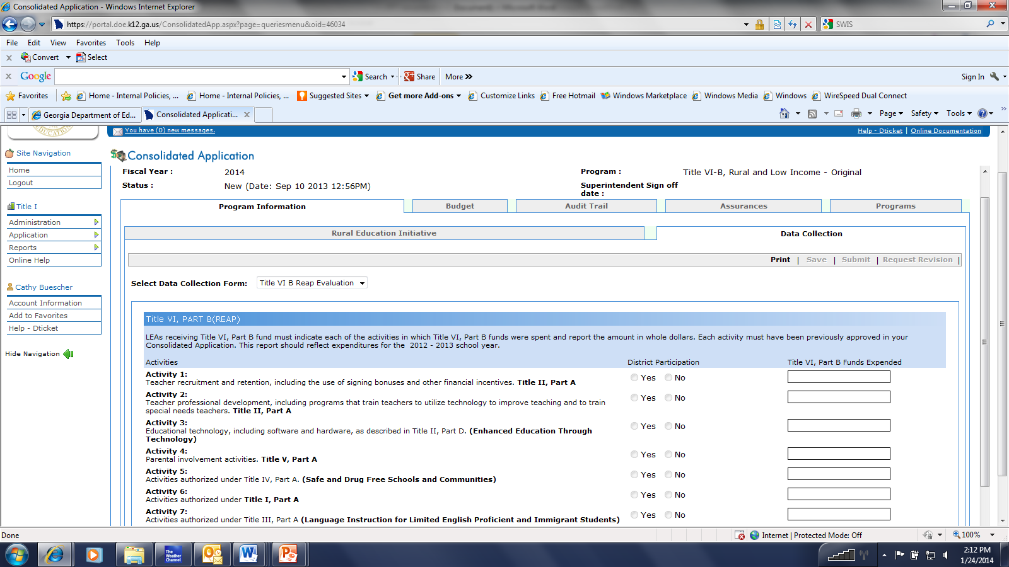
DATA COLLECTION TAB

Slide 59
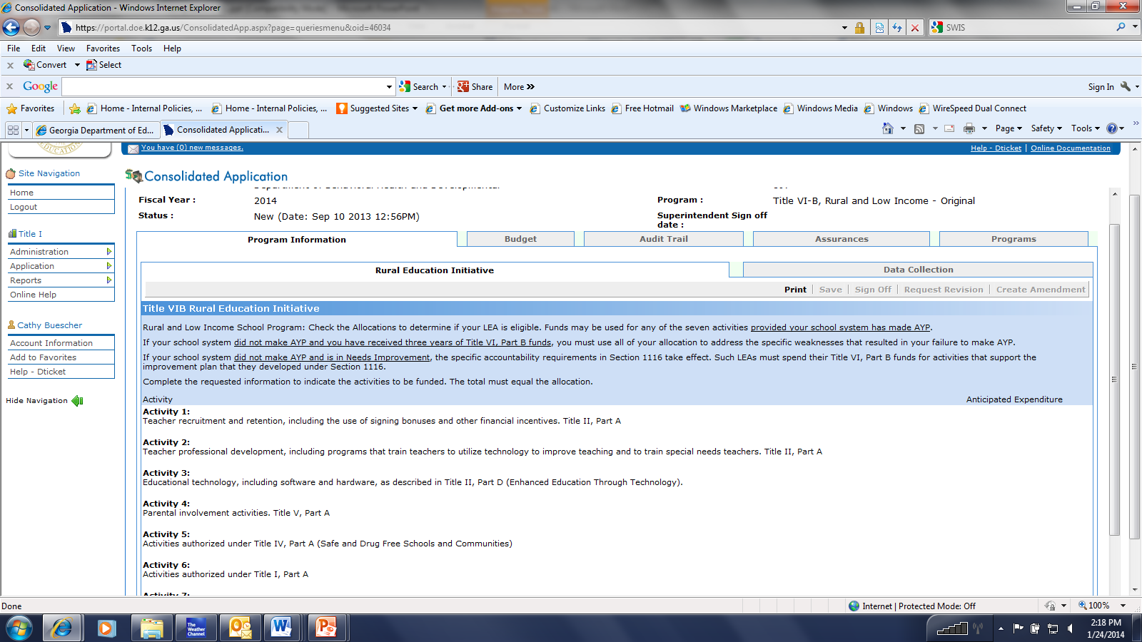
RURAL EDUCATION INITIATIVE TAB

Slide 60
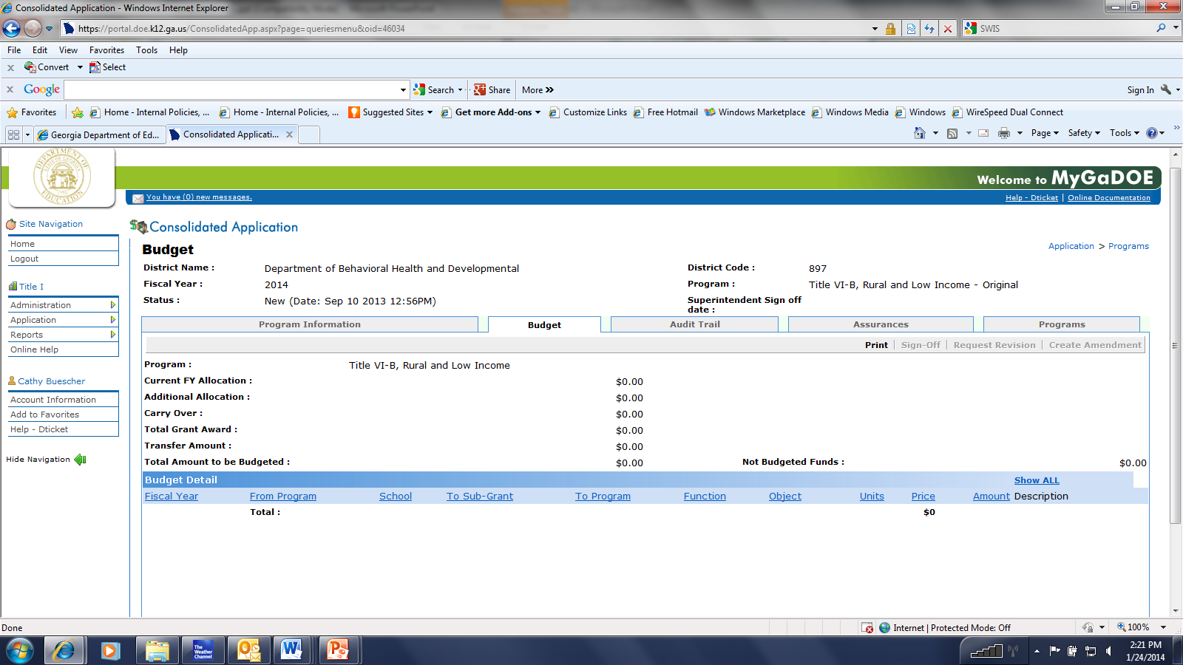
BUDGET PAGES

Slide 61
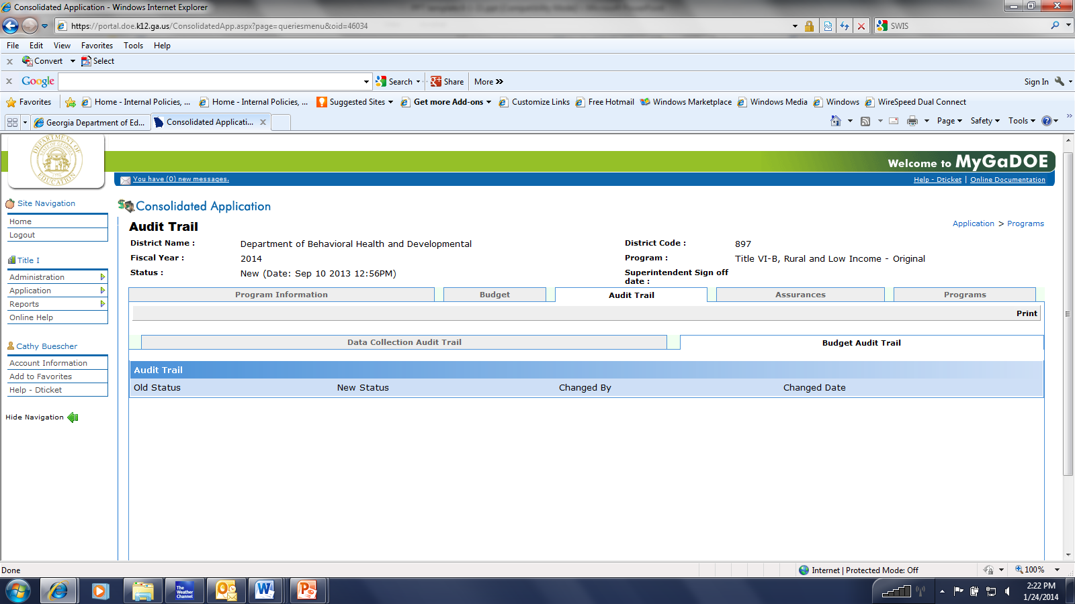
AUDIT TRAILS

Slide 62
Questions?

Slide 63
Resources
State: GaDOE Web site: www.gadoe.org Title Programs
Georgia’s Comprehensive LEA Improvement Plan (CLIP); Program Guidance
ESEA: Title VI, Part B, REAP
Subpart 1: SRSA – Sections 6211 - 6213
Subpart 2: RLIS – Sections 6221 – 6224
Subpart 3: Sections 6231 – 6232
Federal Guidance: http://www.ed.gov/nclb/freedom/local/reap.html.
Rural Education Resource Center:
http://www.ed.gov/rural-education

Slide 64
Contact Information
Cathy Buescher
Education Program Specialist
Title VI, Part B
Rural Education Achievement Program
School Improvement
Federal Programs
cbuesche@doe.k12.ga.us
(229) 561-4499

