Slide 1
Increasing Parent Engagement
In a virtual school setting and beyond
Amy D. Wilcox
Elementary School Assistant Principal & Title I Director

Slide 2
Historical Overview
1965-When Title I was created there was no mention of parent engagement or participation
1966-Federal officials quickly saw the oversight and “encouraged” parental involvement
1967-Local schools “required” parental involvement

Slide 3
The 1978 Parent involvement amendments
Two full sections amending law were dedicated to ensuring parents would be included in the governance of the Title I program.
Required parent involvement in “planning, implementation, and evaluation” of program

Slide 4
Title I and NCLB
Defines parental involvement as “the participation of parents in regular, two way, and meaningful communication involving students academic learning and other school activities Ensuring that
  Parents play an active role in assisting their children’s learning
  Parents are encouraged to be active in their children’s education at school
  Parents are full partners in their children’s education

Slide 5
NCLB
Spells out the six key leverage points for parent involvement schools are required to follow

Slide 6
We all agree!
Parent involvement is crucial to student and school success!
    “Schools with strong family engagement were ten times more likely to improve student learning gains in mathematics”
      (Bryk, sebring, allensworth, luppescu & Easton, 2010).

Slide 7
What’s the problem?
Parents have changed, families have changed, students have changed!

Slide 8

Shifts in lifestyles

Slide 9
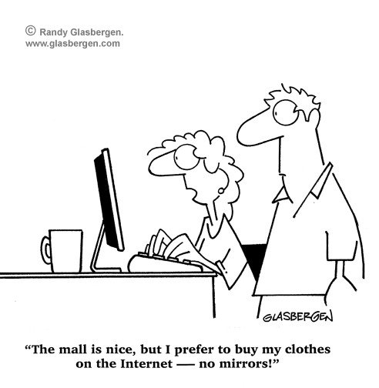
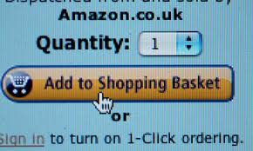
How do you?
SHOP?

Slide 10

Connect with friends?

Slide 11
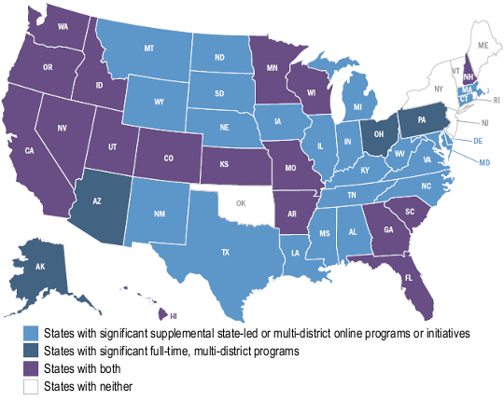
Go to school?
Only 6 States have no virtual Choice
(Parents for choice
In education)
http://www.choiceineducation.org/policy-and-innovations/innovations-across-the-us/636-virtualonline-schools

Slide 12
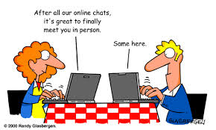

Meet your next boyfriend/girlfriend

Slide 13
So…why can’t get parents engaged in education in the same way?
Create powerful online communities for parents, teachers, and other school staff to engage and collaborate!

Slide 14

Meet Eric Sheninger aka “The Twitter Principal”
As a school leader, Eric believes that effective communication, listening, support, shared decision making and the integration of technology are essential elements necessary to transform school culture.
Uses social media to engage families in the learning process.

Slide 15
If we are to truly improve our practice, we must focus our energy on solutions as opposed to excuses!
  Eric Sheninger

Slide 16

Parent involvement at GACA

Slide 17
We had to think “outside the box”
As a virtual school, there was no roadmap to where we wanted to go.
We believe that our parents and learning coaches are vitally important to the success of our school, but with no school building, how to we meet?
What do we meet about?

Slide 18

Our first and second years?
Did not go as well as we would have liked!
There was an idea of what we wanted and what we knew should be…but no real idea of what to do.
The DOE came to visit and gave us some assistance.

Slide 19
Finally…our third year!
We created a roadmap of what we wanted.
We worked with parents on ideas and activities they were interested in.
We shifted meetings online to different times
We encouraged all teachers to participate in these activities

Slide 20
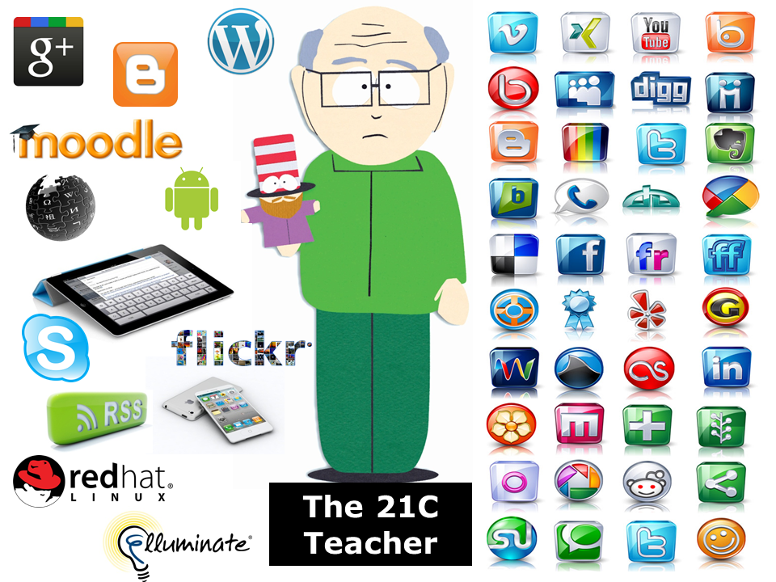
Types of online meetings:
Parent to Parent
Parent engagement meetings (monthly)
Graduation meetings
Learning Coach resource sessions
Cram jams online
Title I Meetings
  Development of the Parent/Teacher Compact
  Annual Title I Meeting

Slide 21
Who? What? Why?
Parent to Parent

Slide 22
Parent Engagement Meetings (Monthly)

Slide 23

High School Graduation Meetings

Slide 24
Learning Coach Resource meetings

Slide 25
Cram Jams online

Slide 26
Required Title I Meetings
Annual Title I meeting
Reviewing the Parent teacher compact
Title I Parent meeting
Title I teacher training

Slide 27
How can this work for me?
Gotomeeting.com
Skype
ClassParrot
Freeconference
Google hangouts
  And more!!!

Slide 28
Examples from GACA
Short examples of various online meetings including:
  High school
  Middle School
  Elementary school
  Whole school
  Title I parent engagement meeting

