Slide 1
Data Mining: A Practical Approach to creating Equitable Learning Opportunities for At-Risk Children
GCEL Conference
Savannah, Georgia
February 25, 2014

Slide 2

What variables create inequitable opportunities in education?

Slide 3
How do you provide
“equality in education for at-risk students?
How do you measure the results?

Slide 4

How is that working for you?

Slide 5




Equitable Learning Opportunities for At-Risk Students
Does this look familiar?
Fiscal Self Assessment
Additional Collaboration with School Improvement Specialists

Slide 6

How do you currently review data
for at-risk groups?
What is the Problem?

Slide 7

Data Faux Pas
Where is the “focus”?

Slide 8
Distribution of Focus Schools in a Large Metro School District
SCHOOL NAME | MAX VALUE | MIN VALUE | GAP | MAX GROUP | MIN GROUP | REASON
School A | 0.790676417 | -3.808957952 | 4.6 | Asian/Pacific Islander | SWD | Achievement
School B | 0.302559415 | -4.28702011 | 4.59 | Asian/Pacific Islander | SWD | Achievement
School C | 0.701096892 | -3.769652651 | 4.47 | Asian/Pacific Islander | SWD | Achievement
School D | 0.521978022 | -3.771585557 | 4.29 | HIS | SWD | Grad Rate
School E | 0.120658135 | -4.077696527 | 4.2 | Hispanic | SWD | Achievement
School F | 0.163619744 | -3.924131627 | 4.09 | LEP | SWD | Achievement
School G | 0.319926874 | -3.65630713 | 3.98 | Asian/Pacific Islander | SWD | Achievement
School H | -0.023765996 | -3.926873857 | 3.9 | Hispanic | SWD | Achievement
School I | 1.037477148 | -2.816270567 | 3.85 | Asian/Pacific Islander | SWD | Achievement
School J | -0.153564899 | -3.870201097 | 3.72 | Black | SWD | Achievement
School K | 0.302197802 | -3.40266876 | 3.7 | HIS | SWD | Grad Rate
School L | -1.395795247 | -4.953382084 | 3.56 | Black | SWD | Achievement
School M | -0.821755027 | -4.34095064 | 3.52 | Hispanic | SWD | Achievement
School N | 0.23583181 | -3.227605119 | 3.46 | Asian/Pacific Islander | SWD | Achievement
School O | -0.445155393 | -3.863802559 | 3.42 | White | SWD | Achievement

Slide 9
Focus School O
MAX VALUE | MIN VALUE | GAP | MAX GROUP | MIN GROUP | REASON
-0.445155393 | -3.863802559 | 3.42 | White | SWD | Achievement
What are the basic assumptions?

Slide 10
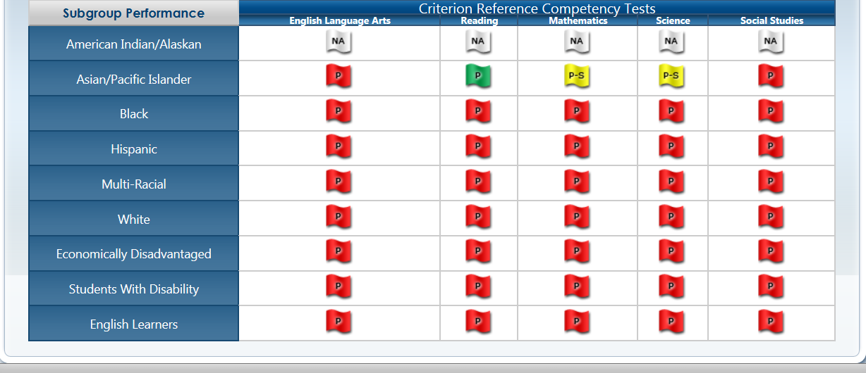
School O doesn’t have a subgroup issue! There is more equity than you know!

Slide 11

Creating equity is more than bubbling in answers or filling in the blanks…
What is the Problem?

Slide 12


Slide 13
Helpful Questions
Did students underperform consistently on all subject areas?
Considering one subject area is the outlier, how did the school’s performance compare to the district and/or the state?
If the school’s performance is commensurate with the broader context, then there may be a curriculum concern that should be address by other stakeholders.
If the school’s performance is below the district and/or state’s performance, then the concern could be unique to that building.
If a large percent of students demonstrated the deficiency in a particular school, then you want to review local curriculum.
Considering that there are no curriculum issues, you should review instructional practices.
How do teachers provide instruction in this area? Are they using evidence based and/or research based practices?

Slide 14
More Helpful Questions
How does the performance of the subgroup compare to the performance of “All Students”?
How does the performance of the subgroup compare to the performance of other subgroups?
Considering the school has a “true subgroup issue” (i.e., students with disabilities), what variables are making the difference for the other subgroups?
Considering the underperforming students, what are the relevant trends?
What kinds of information can be concluded from the progress monitoring data?
Are these students represented among multiple subgroups such as EL and ED?

Slide 15

I vow not to change the contents of the “plan” regardless…!

Slide 16
How well is the solution working?
What is the Problem?
Problem Solving Process
What shall we do about it?
Why is it happening?

Slide 17
Digging the Data
What does the data tell us?
Are there valid trends?
How relative is the data to other data sets?
What other questions do we have?
How well is the solution working?
What is the Problem?
Problem Solving Process
What shall we do about it?
Why is it happening?

Slide 18

Based on your perspective, what are the trends? Keep mining the data until something sticks!
State
Region
District
School

Slide 19
How well is the solution working?
What is the Problem?
Problem Solving Process
What shall we do about it?
Why is it happening?
Thinking about “Why”
Why do we have the data we have?
Is it an “all students” issue, subgroup issue, or student issue?
Are there necessary changes for curriculum and/or instruction?
What are the “true” barriers?

Slide 20

Identify the barriers (why) contributing to the challenges. Go deep enough to ensure you found the root cause of the problem.

Slide 21

Why do we have the data that we have? Sometimes, asking “why” forces you to redefine the “what”!

Slide 22
How well is the solution working?
What is the Problem?
Problem Solving Process
What shall we do about it?
Why is it happening?
Planning and Implementing
How can we address barriers and develop an effective action plan?
What data will inform us that these activities are working?
How will we ensure fidelity of implementation?

Slide 23

Devise a plan to address the main causes of the problem. Ensure that each plan is measurable!

Slide 24
Reflecting, Celebrating & Regrouping
Are we getting the desired results?
How can we celebrate small successes?
How can we adjust plans, as needed?
How well is the solution working?
What is the Problem?
Problem Solving Process
What shall we do about it?
Why is it happening?

Slide 25

Don’t forget to check your progress…Monitor and Adjust!

Slide 26

What does my school’s enrollment look like (e.g., racial/ethnic group and disability category)?

Slide 27
How do I begin to put a face on the at-risk subgroup within the subgroup?

Slide 28
Specific Learning Disabilities
Black
Hispanic
Speech/Language Impairment
Economically Disadvantaged
English Language Learner
Pacific Islander
Asian
Autism
White
Intellectual Disabilities
Other Health Impairments
Emotional & Behavioral Disorders

Slide 29
Are there trends among the at-risk students? If so, how can you address these barriers first?

Slide 30
General Education Setting
Course Completion
Behavior
Economically Disadvantaged
Transient
Attendance
Developmental Delays
Homelessness

Slide 31
How can I apply the problem solving framework to resolve student-level issues?

Slide 32
How well is the solution working?
What is the Problem?
Problem Solving Process
What shall we do about it?
Why is it happening?

Slide 33

Next Steps

Slide 34
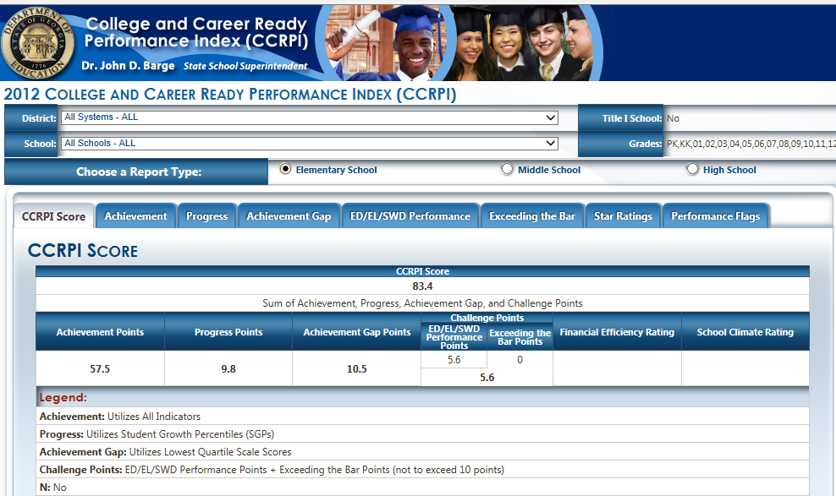

Slide 35
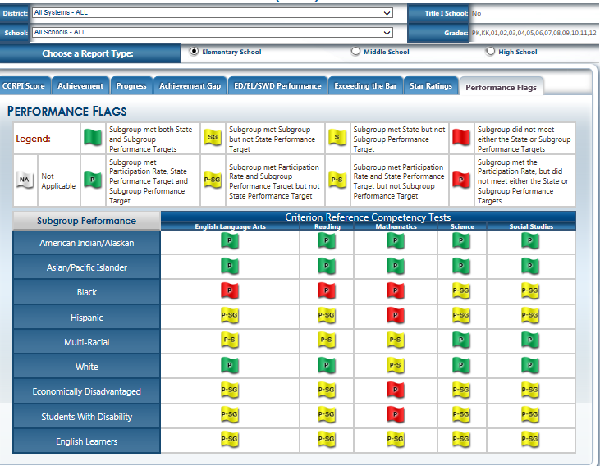

Slide 36
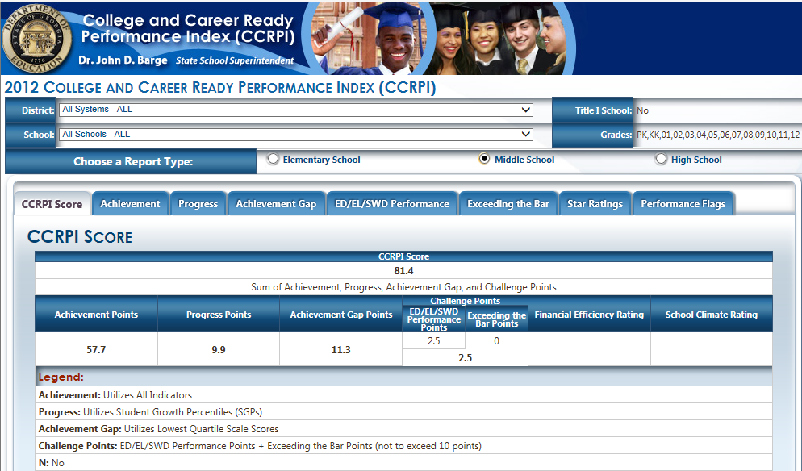

Slide 37
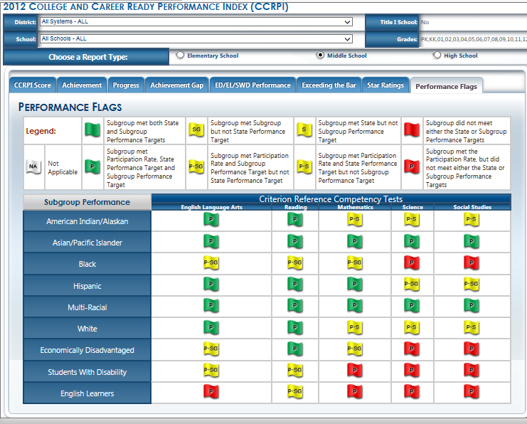

Slide 38
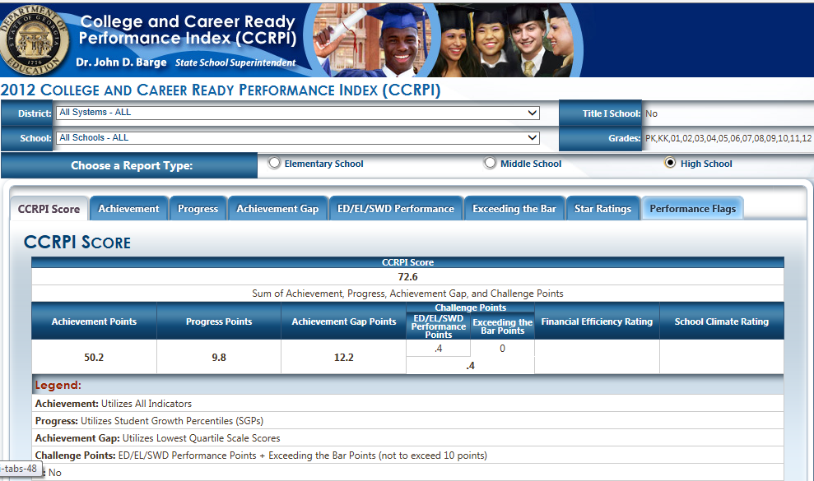

Slide 39
